Slide 1
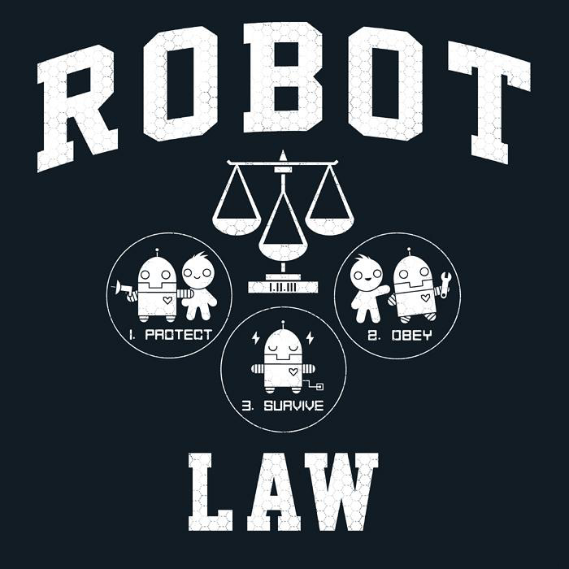
The Three Laws of Robotics
And how it is not that simple for robots to stick to three performing principles

Slide 2
First Law
A robot may not injure a human being or, through inaction, allow a human being to come to harm.
Second Law
A robot must obey the orders given it by human beings except where such orders would conflict with the First Law.
Third Law
A robot must protect its own existence as long as such protection does not conflict with the First or Second Law
What are the Laws of Robotics
Zeroth Law
A robot may not harm humanity, or, by inaction, allow humanity to come to harm.
These are the Laws that the robot must perform

Slide 3
Are we straying away from these Laws
Are the laws obsolete Now.
Have robots evolved past the laws
Are new laws needed
Are the laws simply too simple for the complexities of robots of today
If we have Strafed from the original intended performance of the robot then what should be the modern performances of a robot

Slide 4
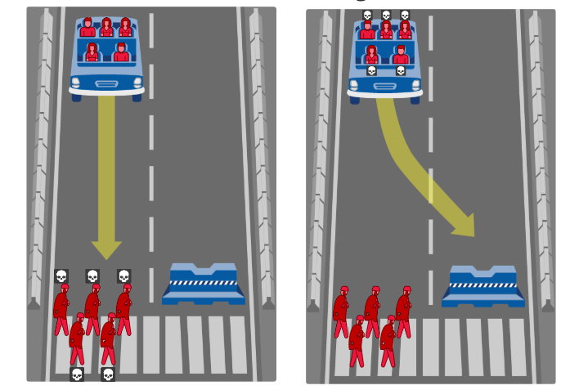
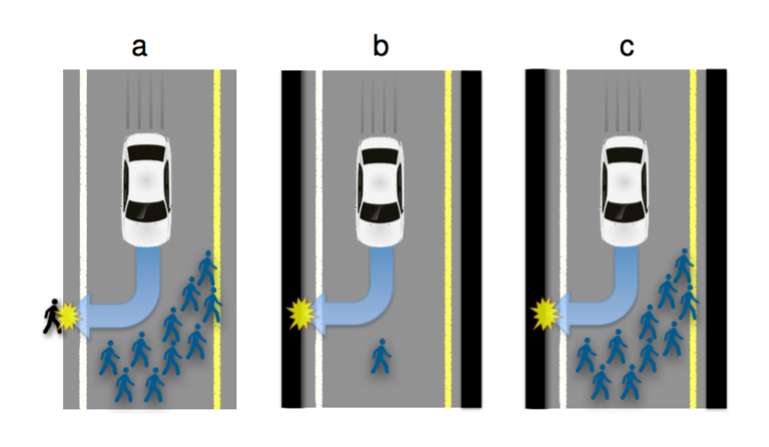
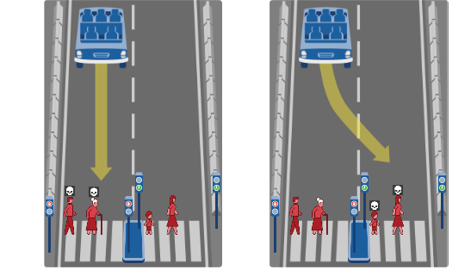
Should Robots Perform Bias
Should the homeless person be sacrificed because he is not contributing to society
Should an elderly chosen because they have done their part and are no longer needed
Should the person not on the road be sacrificed because this will reduce the overall net loss even though he was not part of the incident
Should a robot choose who is worth living depending on social norms based on gender, income, productivity

Slide 5
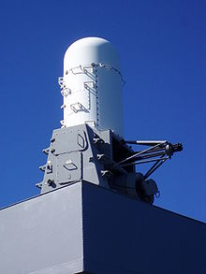
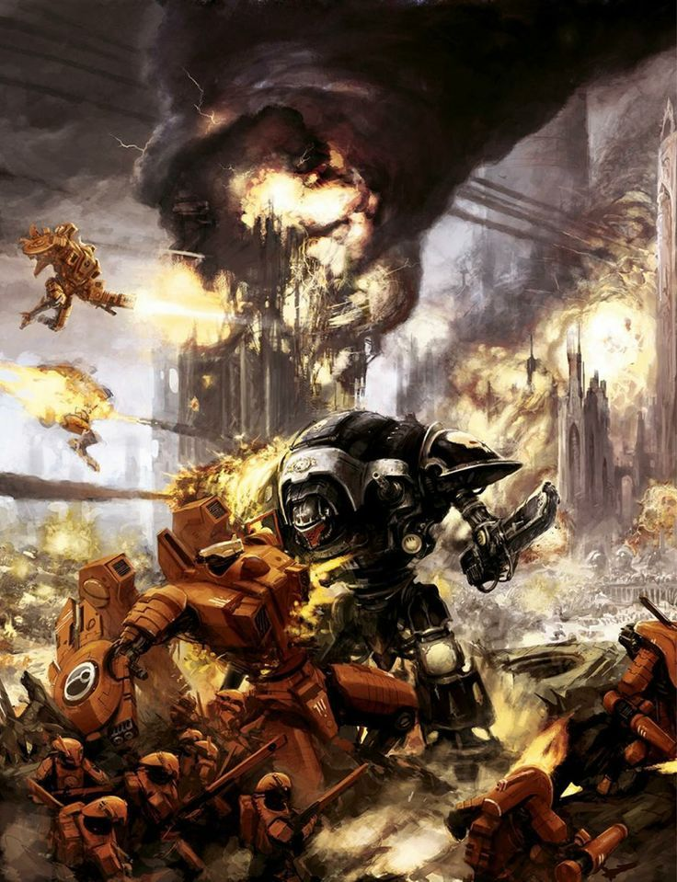
Should a robot perform hostility
Are these robots Performing?
Does it abide to the three Laws?
Both Robots are protecting their creators.
But at what point is the robot not upholding its laws but rather fallen into the same trap as humans. Inheriting the flaws of human nature. Projecting race, hatred and no other manner of logical thinking.

Slide 6
Should Robots perform Human Nature
Do robots need rights
Should robots behave differently to people depending on their appearance
Should robots be competitive against humans in work environments
Should robots have the ability to make thoughts, generalizations and preferences
Should robots' express emotions
Should a robots be judged by other robots depending on the company that created it

